Slide 1

Project TITLE: Diabetes Detection using Machine Learning Student names & USNs: Rohan Sudan (2021a1r016) Rupak Choudhary (2021a1r028)

Slide 2
Identification of Problem and Detailed Analysis
Potential for AI in the problem domain with industrial relevance:
Early Detection and Prevention Programs
Personalized Treatment
3. Population Health Management
4. Personalized Medicine and Treatment Optimization
5. Drug Discovery and Development
Statement of the problem:
To develop a machine learning model that can predict diabetes by analyzing diverse patient data to accurately predict the likelihood of diabetes, facilitating early intervention and personalized treatment strategies.

Slide 3
Identification of Problem and Detailed Analysis
Purpose and uniqueness of the project:
The project's unique focus lies in developing a robust machine learning model capable of accurately predicting the likelihood of diabetes based on a comprehensive set of clinical and demographic features.
Unlike traditional diagnostic approaches, the project emphasizes personalized risk assessment by analyzing individual patient characteristics.
By harnessing the power of machine learning algorithms, the project aims to address critical challenges in diabetes care, including timely diagnosis, personalized treatment planning, and preventive interventions.
The project integrates machine learning into healthcare systems to enable real-time monitoring and decision support for diabetes care.

Slide 4
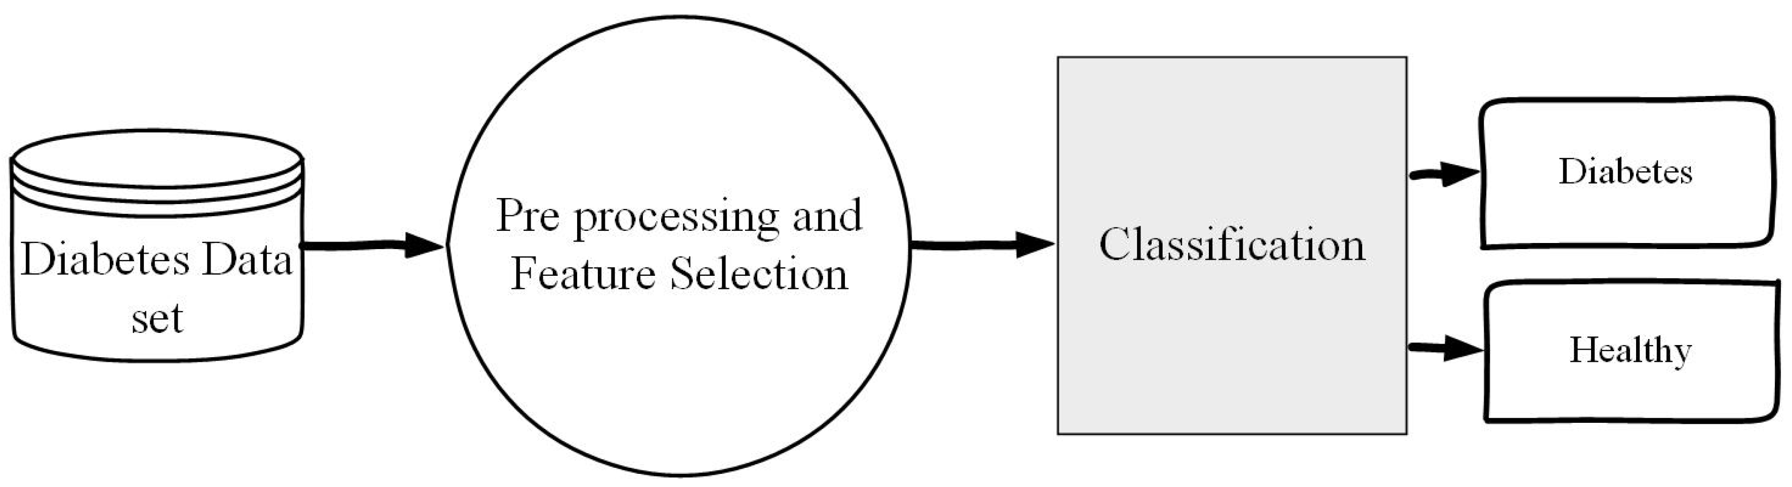
Objectives
1. To detect diabetes at an early stage or even predict the risk of developing diabetes .
2. Accuracy and Reliability.

Slide 5
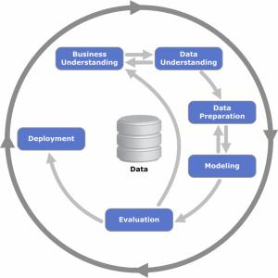
Methodology
1. Data Collection
2. Data Preprocessing
3. Feature Selection
4. Model Selection
5. Model Training and evaluation
6. Analysis and Visualization
7. Interpretation and Insights

Slide 6
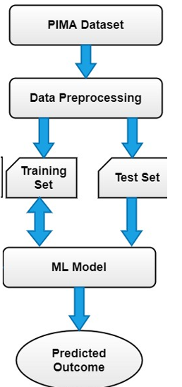
Design

Slide 7
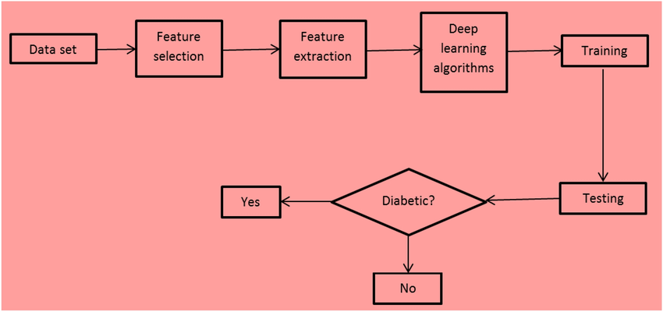
Design

Slide 8
Implementation
1.Data Collection Module:
Responsible for gathering relevant datasets containing features such as patient demographics, clinical measurements (e.g., blood glucose levels), lifestyle factors, and medical history.
Retrieves data from sources such as electronic health records (EHRs), medical databases, surveys, wearable devices, and public repositories.

Slide 9
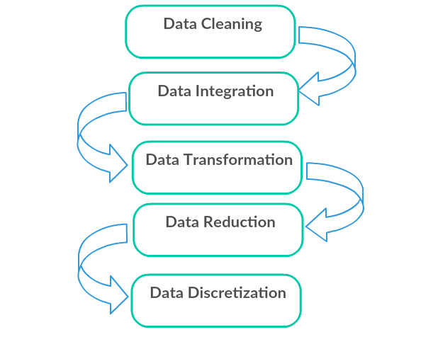
Implementation
2.Data Preprocessing Module:
Cleans and preprocesses the raw data to handle missing values, outliers, and noise.
Performs tasks such as data imputation, outlier detection, data normalization, and feature scaling to ensure data quality and consistency.

Slide 10
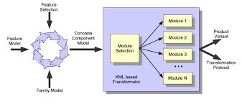
Implementation
3.Model Selection Module:
Selects appropriate ML algorithms for diabetes detection based on the nature of the data and the problem at hand.
Explores a variety of algorithms such as logistic regression, decision trees, random forests, support vector machines (SVM), k-nearest neighbors (KNN), and deep learning models. Considers ensemble methods and model stacking techniques to combine multiple models for improved performance.

Slide 11
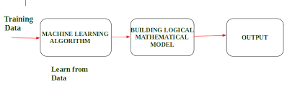
Implementation
4.Model Training Module:
Splits the preprocessed data into training and validation sets using techniques such as k-fold cross-validation or stratified sampling.
Trains the selected ML models on the training data, optimizing model parameters using techniques such as grid search, random search, or Bayesian optimization.

Slide 12
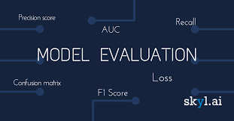
Implementation
5.Model Evaluation Module:
Assesses the performance of trained models on the validation set to evaluate their generalization ability and robustness.
Compares the performance of different models using appropriate metrics such as accuracy, precision, recall, F1-score, area under the receiver operating characteristic (ROC-AUC) curve, and confusion matrix.

Slide 13
Experimental Results & Analysis
Evaluation Metric:
Accuracy: The proportion of correctly predicted labels compared to the total number of samples.
•Precision: The ability of the model to correctly identify positive samples among the predicted positive samples.
•Recall: The ability of the model to correctly identify positive samples among the actual positive samples.
•F1 Score: The harmonic mean of precision and recall, providing a balanced measure of both metrics.
•Mean Absolute Error (MAE): The average absolute difference between predicted and actual values.
•Mean Squared Error (MSE): The average squared difference between predicted and actual values, giving higher weight to larger errors.
•Root Mean Squared Error (RMSE): The square root of MSE, providing a metric in the same unit as the target variable.
•R-squared (R2): Measures the proportion of the variance in the target variable explained by the model. It indicates the model's goodness of fit.
•Mean Average Precision (MAP): Calculates the average precision at each relevant item position and averages them.

Slide 14
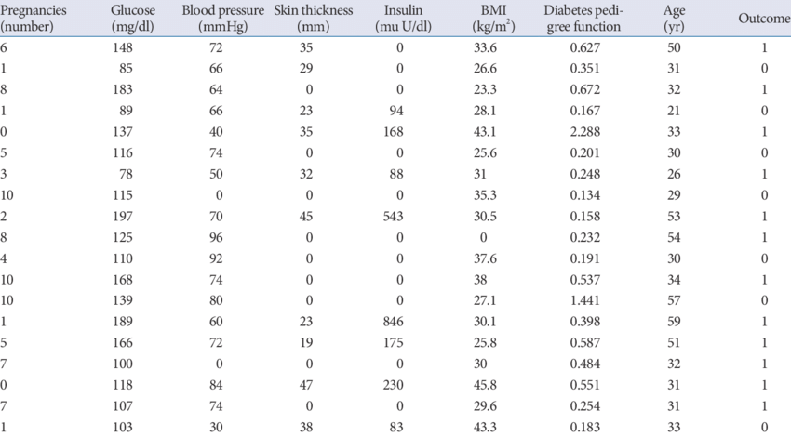
Experimental Results & Analysis
Experimental Dataset:
The Pima Indians Diabetes Database is a commonly used dataset for diabetes detection research. It contains various clinical and demographic features, along with a target variable indicating diabetes status (0 for non-diabetic, 1 for diabetic).

Slide 15
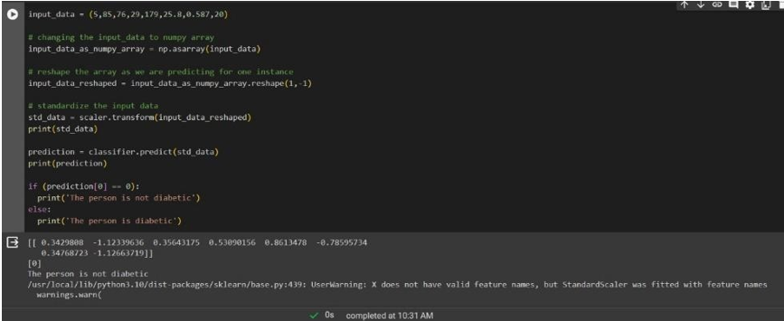
Demonstration of the project
In this result we can see that a person with 5 pregnancies, 85 glucose level, 76 glucose level, 29 skin thickness, 179 insulin, 25 bmi, 8 diabetes pedigree function, and 20 years old is not diabetic

Slide 16
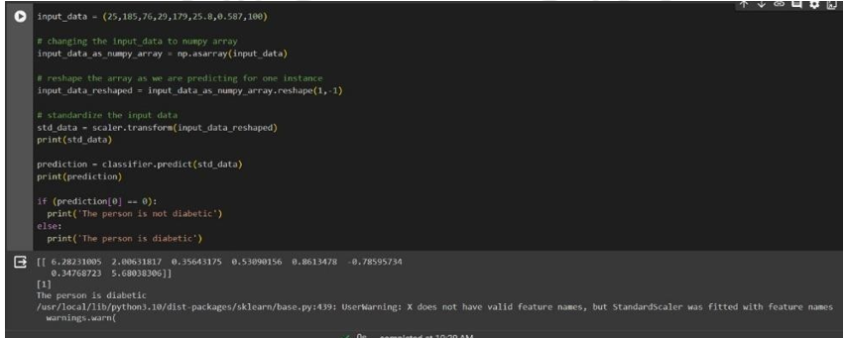
Demonstration of the project
In this result we can see that a person with 25 pregnancies, 185 glucose level, 76 glucose level, 29 skin thickness, 179 insulin, 25 bmi, 8 diabetes pedigree function, and 100 years old is diabetic

